Slide 1
How I like spaghetti? In my plate, not in my code !
From clean code to clean architecture. Some key factors for a successful software project.
Alexandru Lungu, Senior Software Developer | Full-Stack

Slide 2
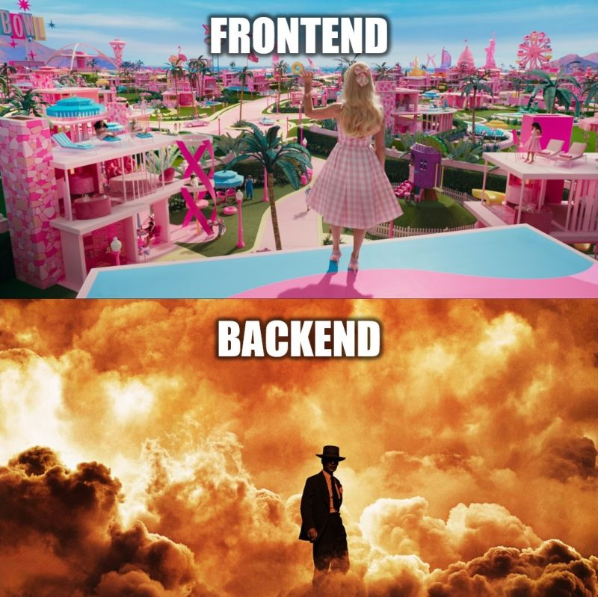

Slide 3
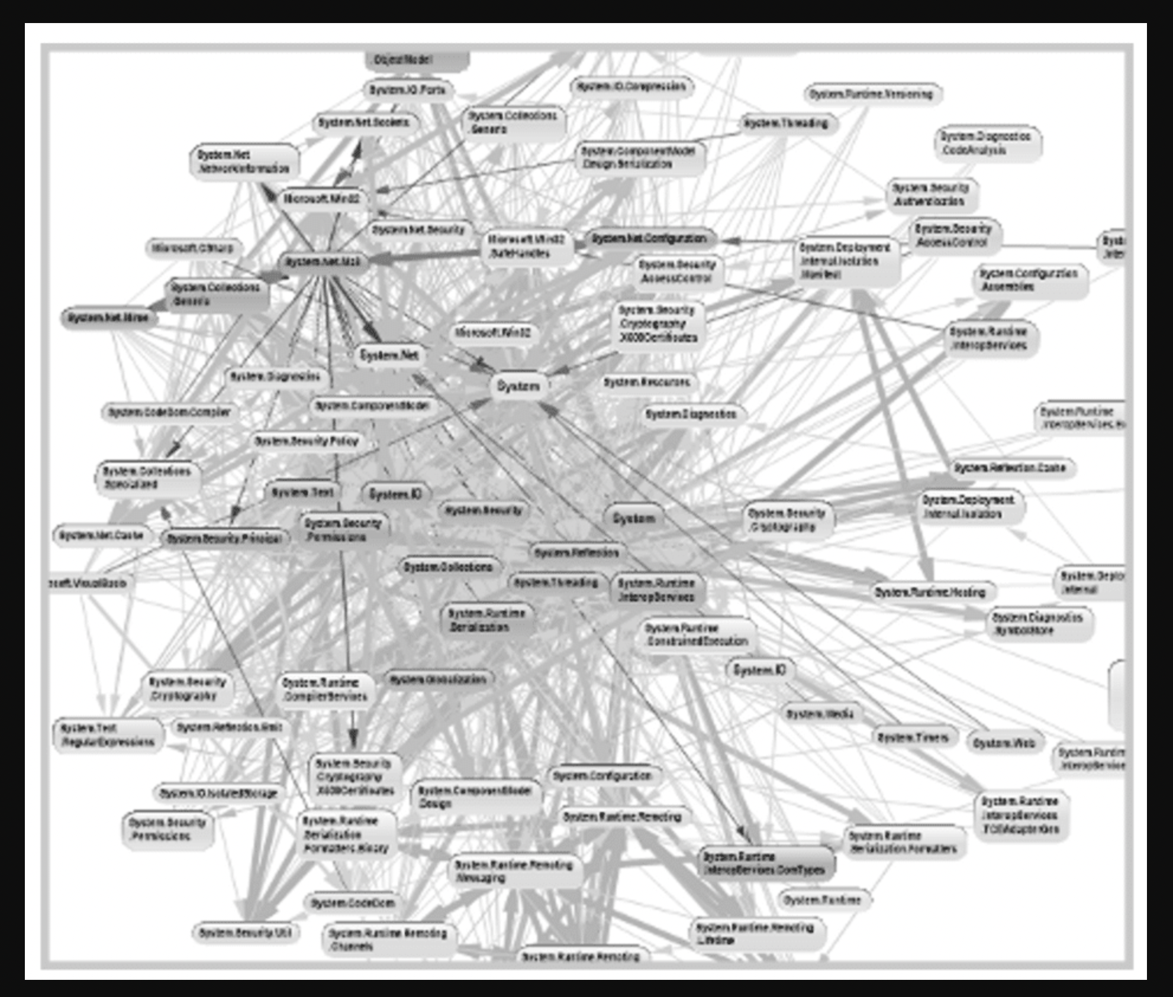
E.On Development Guild
dds
Monolith class dependency graph (big ball of mud)

Slide 4
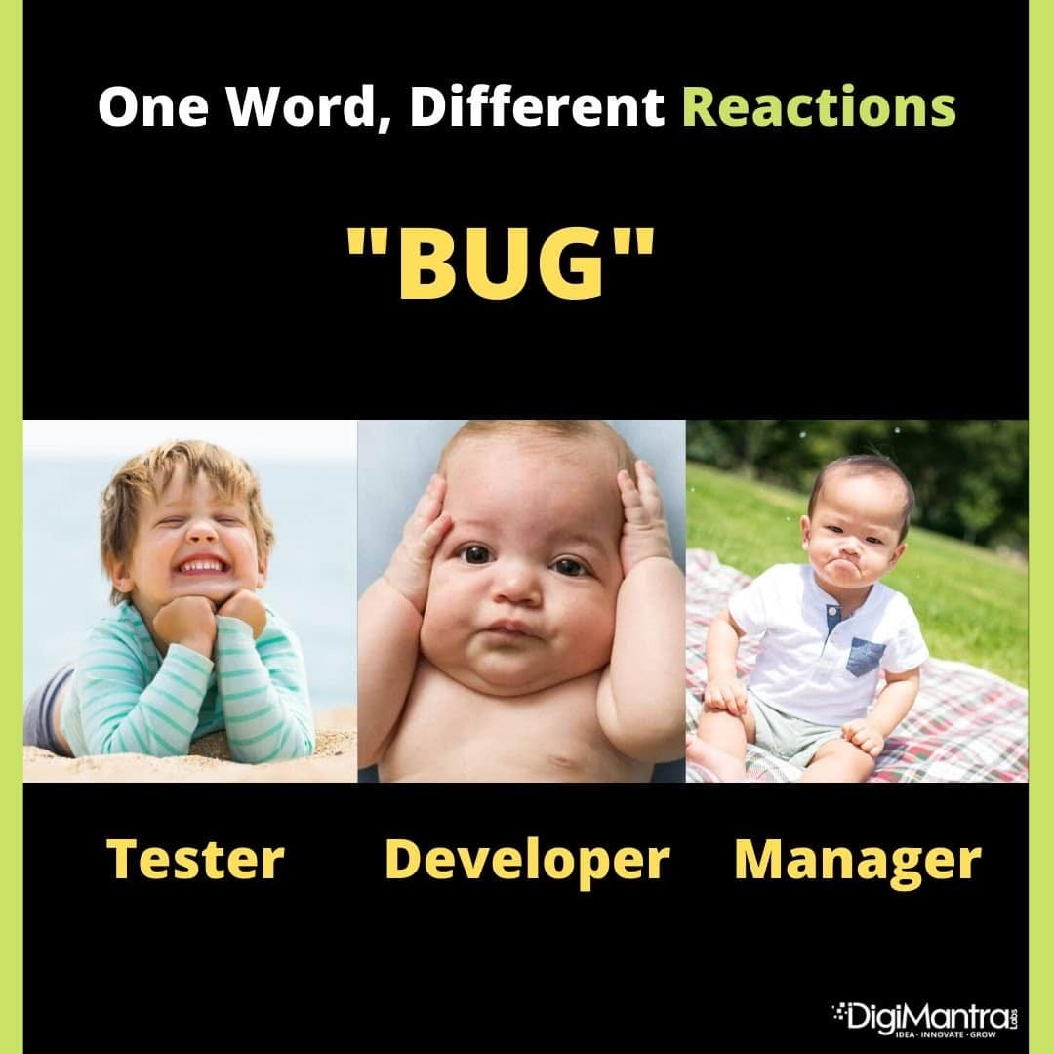

Slide 5
Solution: SOLID principles and Hexagonal architecture

Slide 6


Slide 7


1. Single Responsibility Principle.
Single Responsibility Principle A class should have only one reason to change
Employee Service
…
calculatePay()
print()
save()
Employee Service |  |  | Employee Repository
… |  |  | save(employee)
calculatePay()
 |  |  | Print Service
 |  |  | print(employee)

Slide 8

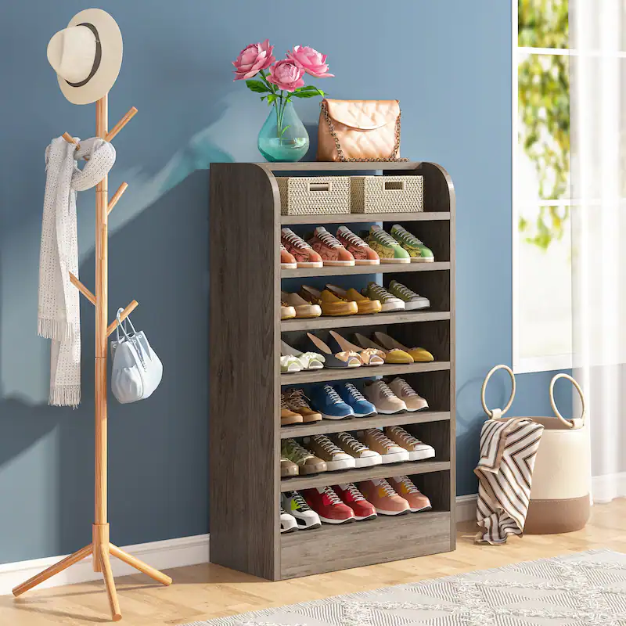
SRP, how ?
Dinner table Bounded context
Shoes cabinet Bounded context
High Cohesion
High Cohesion
Loose coupling

Slide 9
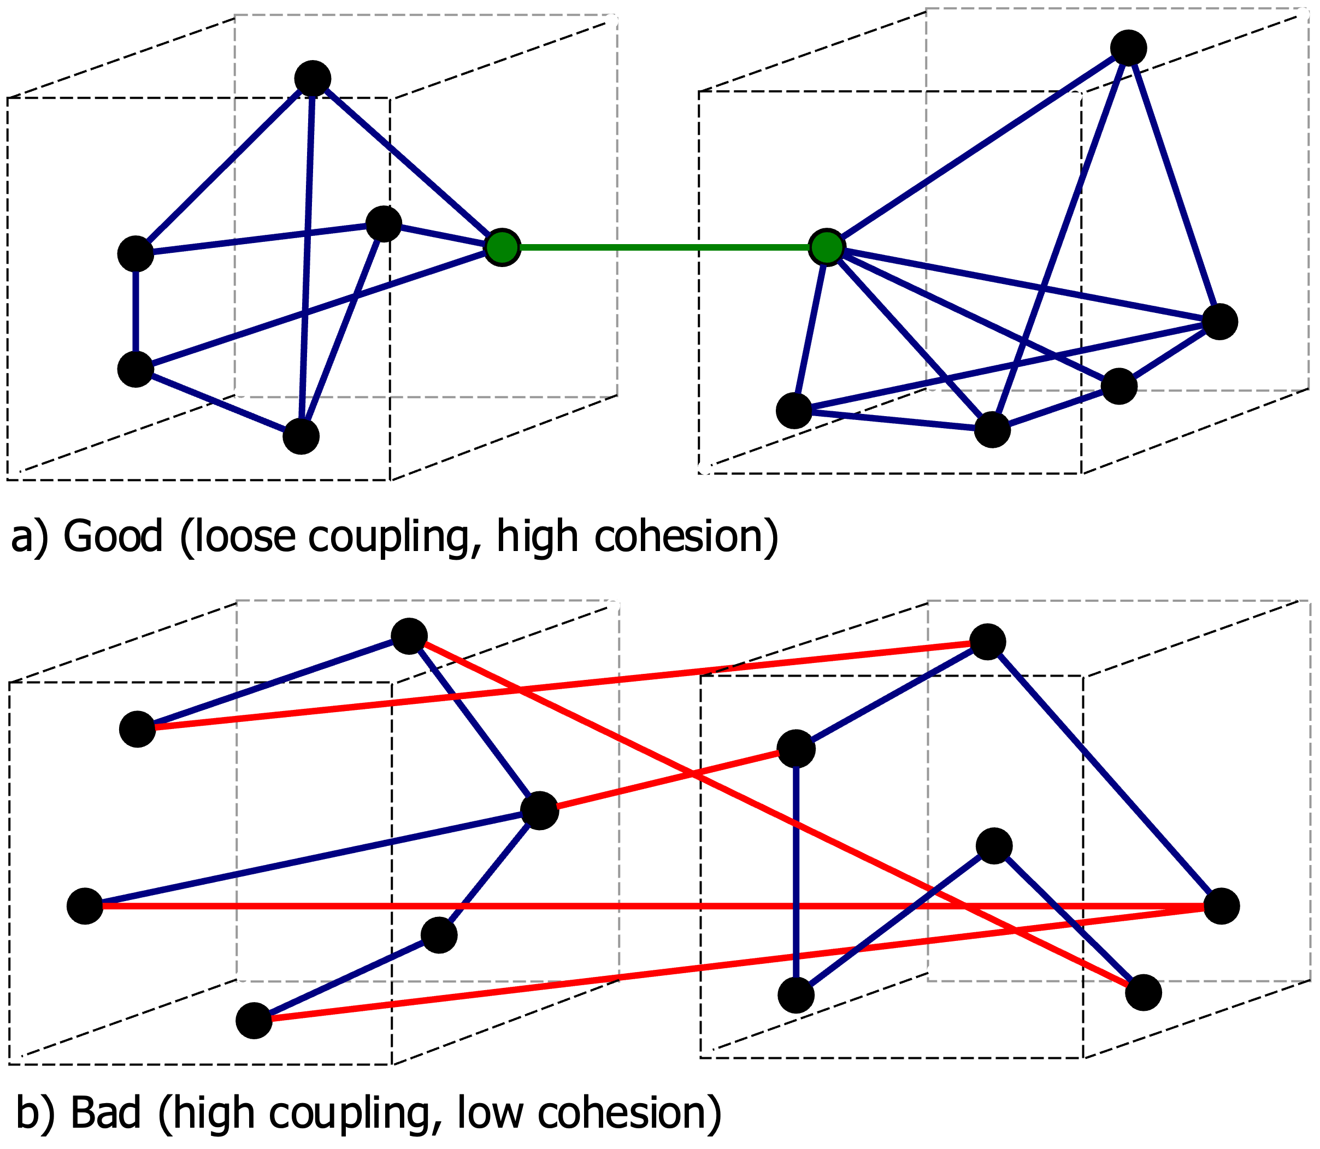
high cohesion and loose coupling
For clean architecture, we need high cohesion and loose coupling.

Slide 10
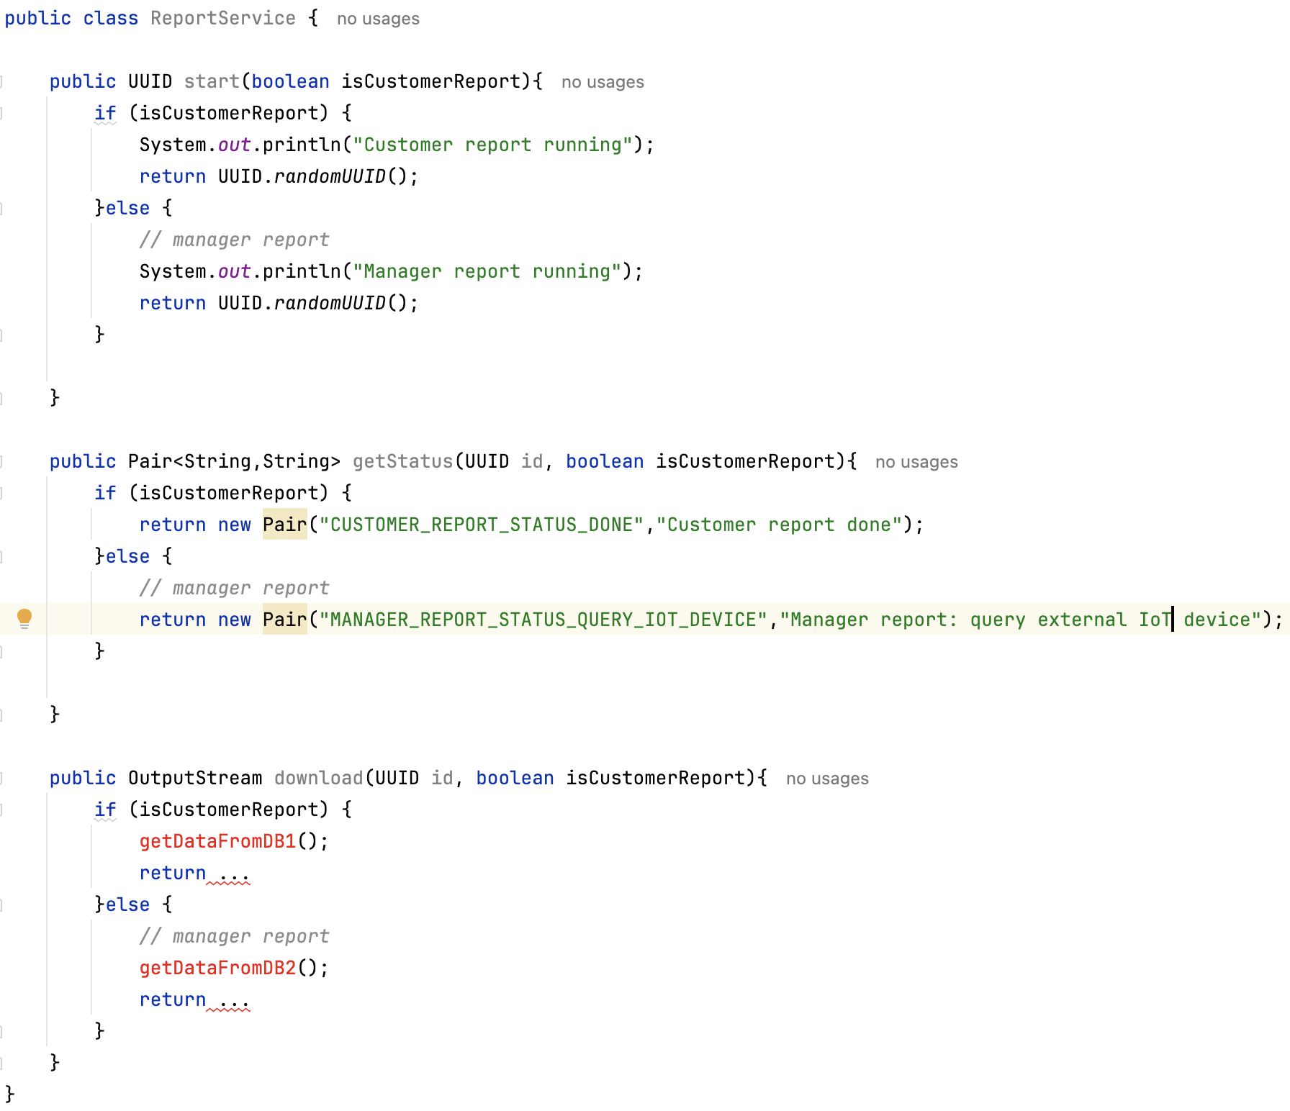
add logic with flags

Slide 11
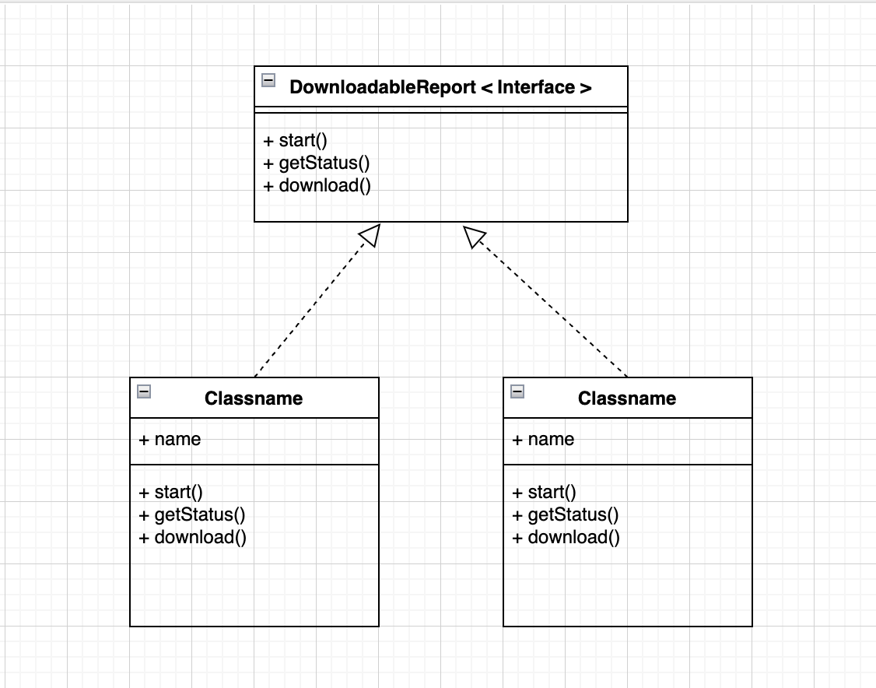
2. Open Closed Principle
A class should be open for extension, and closed for modifications

Slide 12
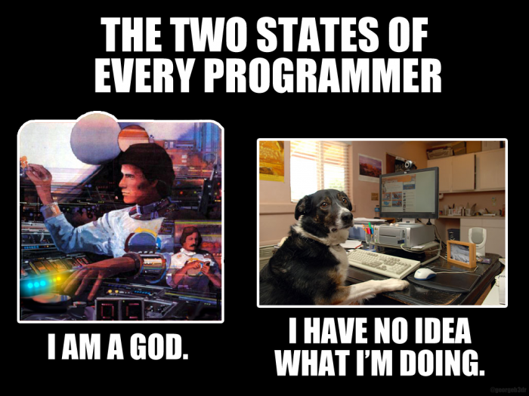

Slide 13
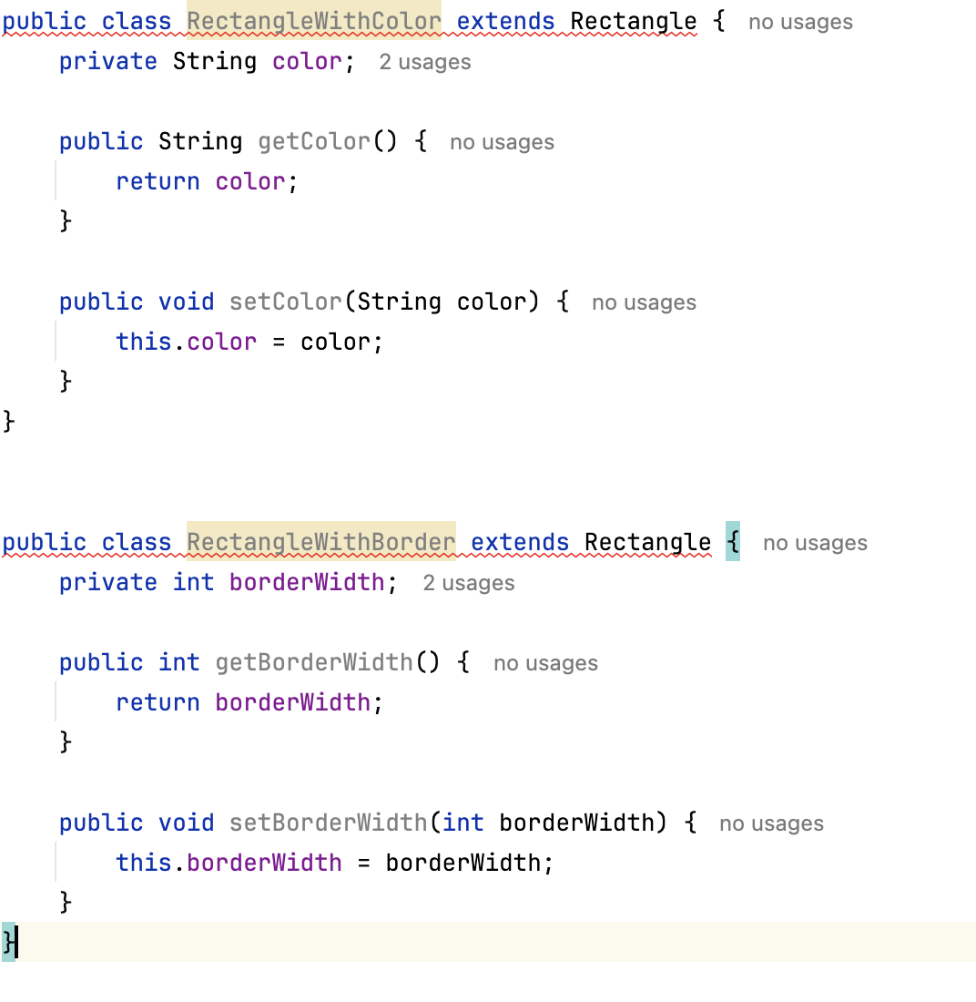
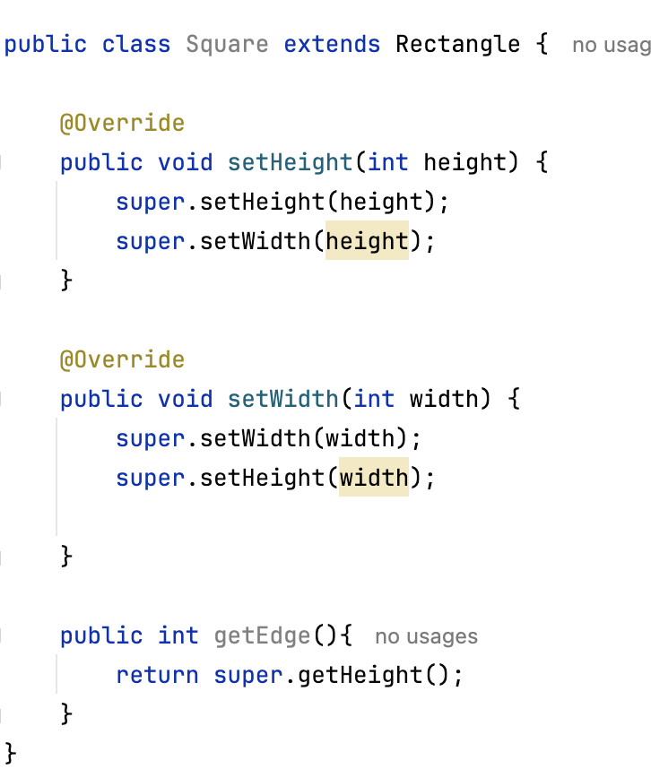
3. Liskov Substitution Principle (enables polymorphism)
A sub class, can be assigned to a super class.

Slide 14
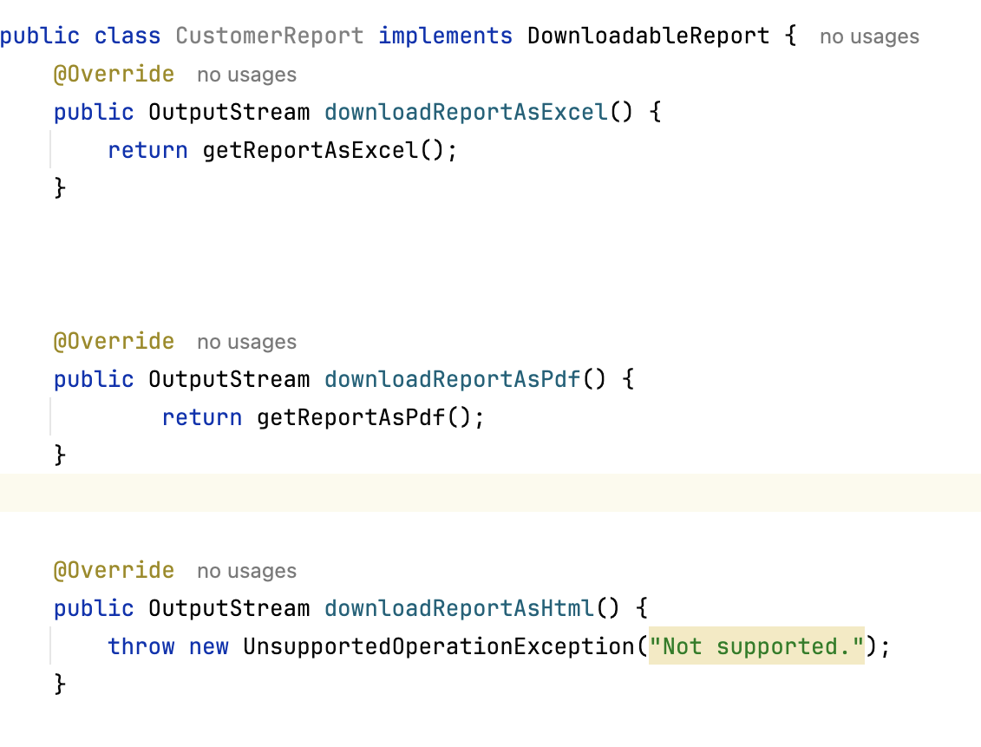
4. Interface Segregation Principle
A class should not be forced to implement methods. Avoid big Interfaces, make smaller interfaces

Slide 15
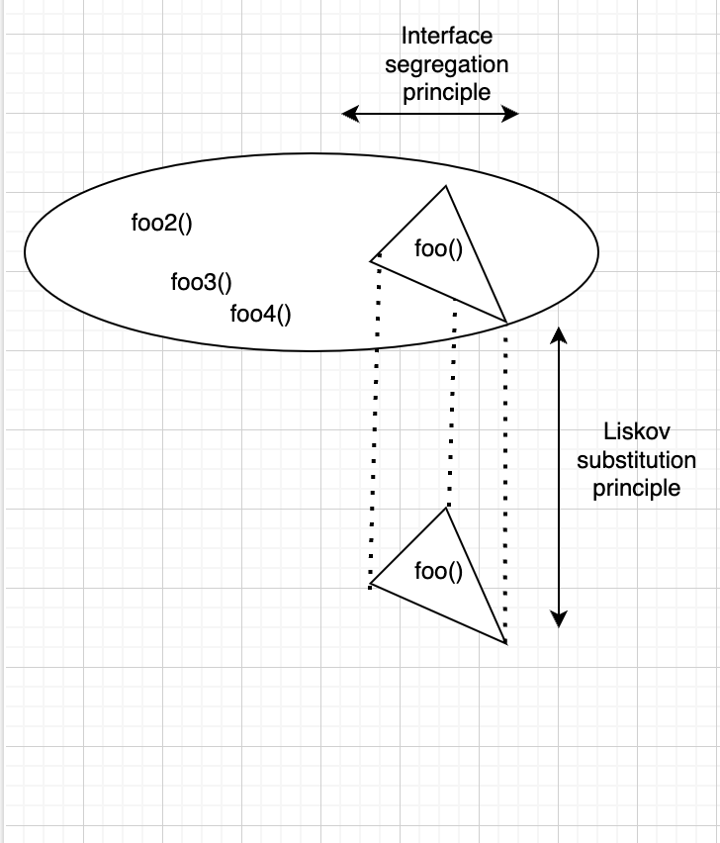
Link between LSK and ISP
Liskov substitution principle (LSP) is more important than Interface segregation principle (ISP)

Slide 16
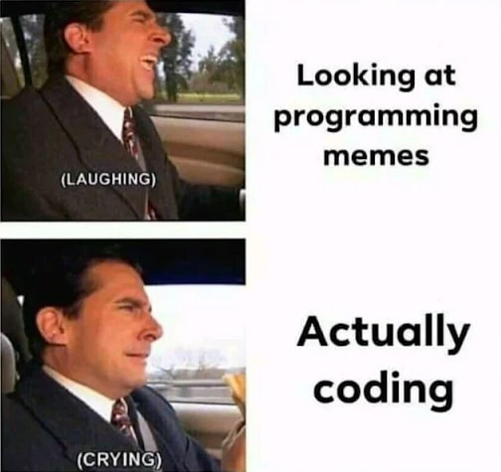

Slide 17
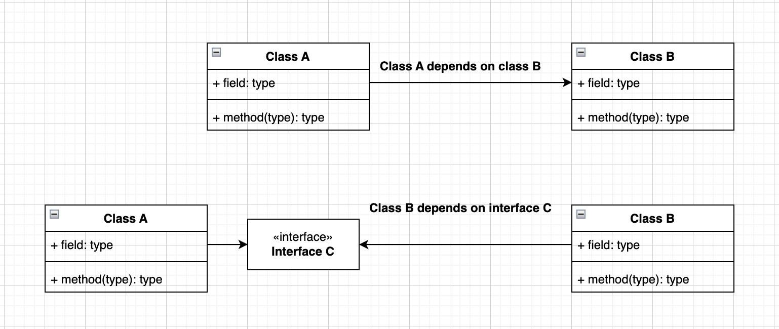

5. Dependency inversion
A class should depend on abstractions, not concrete classes
If we add an abstraction (interface) between Class A and Class B, Class A will depend on
that abstraction. Class B will implement that abstraction. This way, the dependency will be inverted

Slide 18
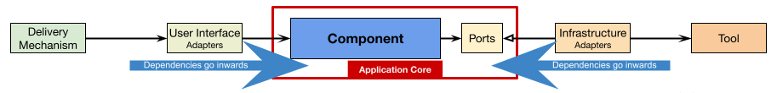
Dependency inversion
The ports(interfaces) are placed in the Application layer. The implementations (adaptors) are present in infrastructure layer (in another folder/package/DLL).
The advantages of depending only on abstractions:
The developer can easily mock modules for testing purpose (e.g.: Junit);
Other developers can understand easy understand the port logic ( port= just an interface)
The Application layer is isolated from Infrastructure logic (different folders/packages)
One can easly change one module with another module( ex: change MySql database with Postgres Database engine)
The modules can be transformed into Microservices and extracted in independent deployable modules

Slide 19
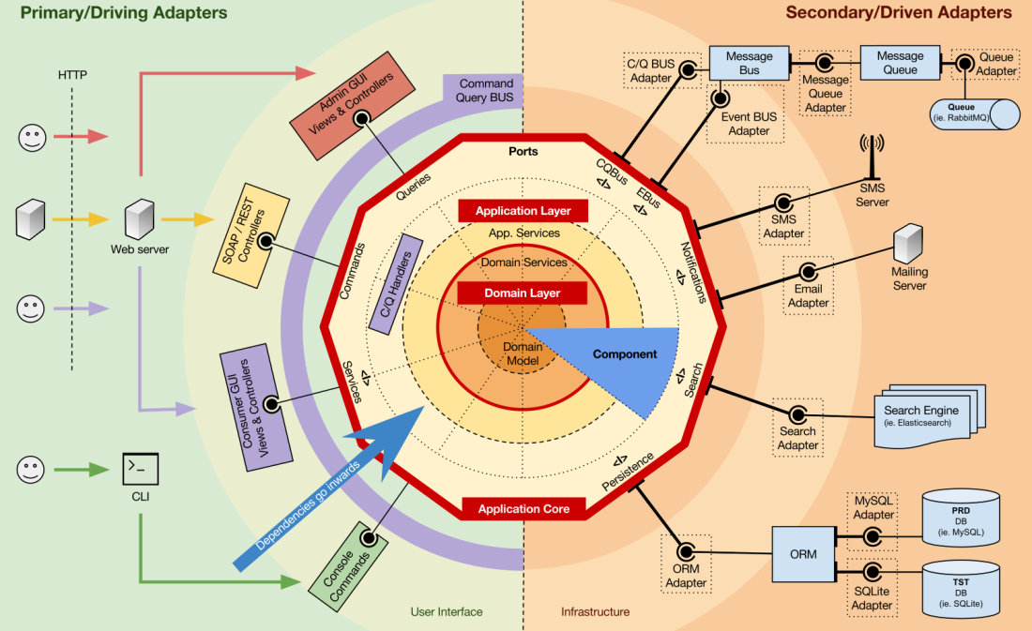
Hexagonal Architecture

Slide 20
Hexagonal Architecture
The dependency direction points to the center of the diagram.
Outer layers can access/see inner layers.
The Business use cases and the transactions will be located in Application layer . Framework annotations will be present here. E.g. : @Transactional.
The Business domain models are isolated in the Domain layer (plus domain model validations). No frameworks dependency should be found here. This way, it’s easy to rewrite the application in other languages, if needed, or it will be easy to port the application to other framework.

Slide 21
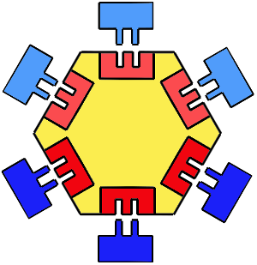
Hexagonal Architecture – Modular Monolith
Module
Module
Module
Module
Module
Module
Modules can be easily replaces with other modules (plug and play)
In future, modules can be extracted as microservices, to address problems as scalability, fault tolerance, security, multiple teams

Slide 22
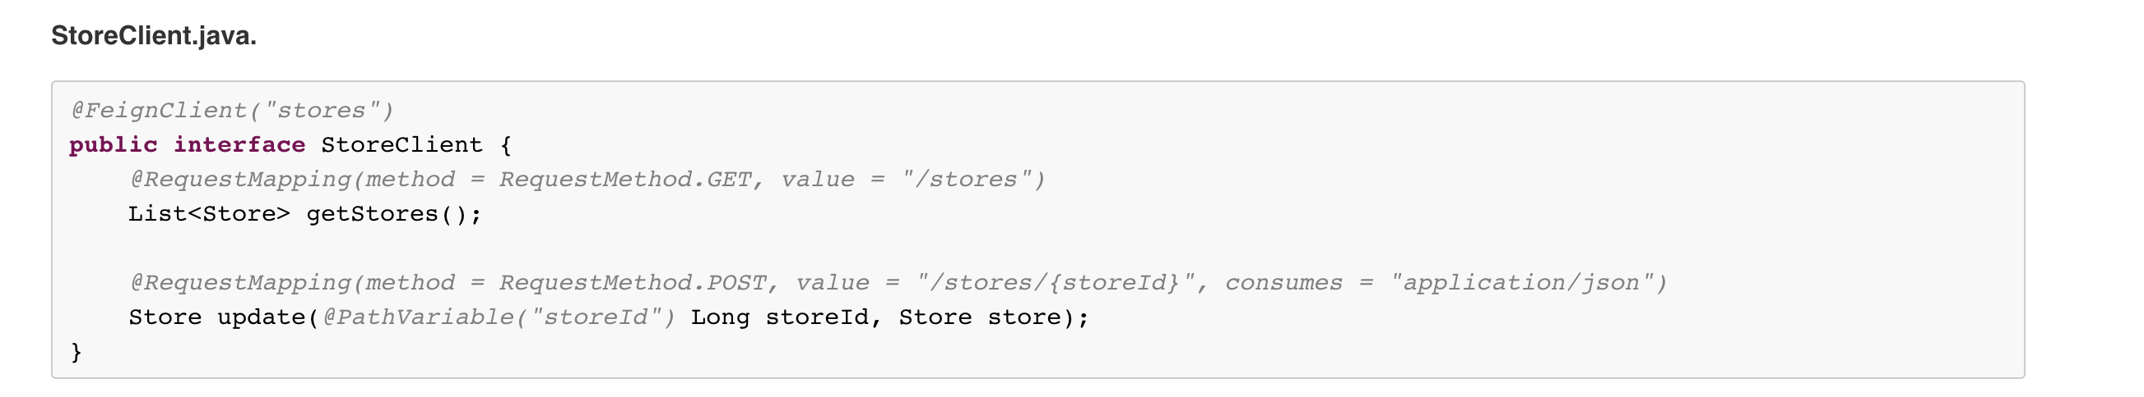
Use Feign Client to abstract a service or a microservice

Slide 23
Architecture (find the right tool for the problem )
Microservices
Monolith
Modulith
When not to choose microservices ?
MVP
Startups
Greenfield
Modular monolith= modules and one database
Google
Amazon
Netflix
Microsoft

Slide 24
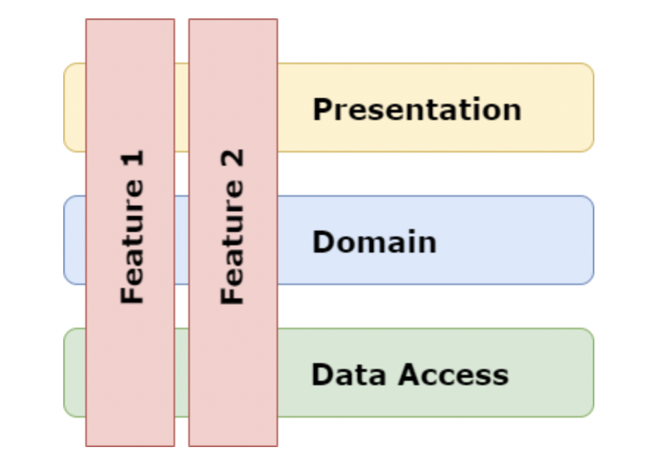
Vertical Slice
How to migrate from a monolith to microservices?
Problem: Big ball of mud
Solution: Vertical slice Architecture= isolate different features. Can transform a monolith into a modular monolith. In future, those vertical slices can be extracted into a microservice
Vertical slice Architecture = High Cohesion over Business capability, not over technology layers

Slide 25
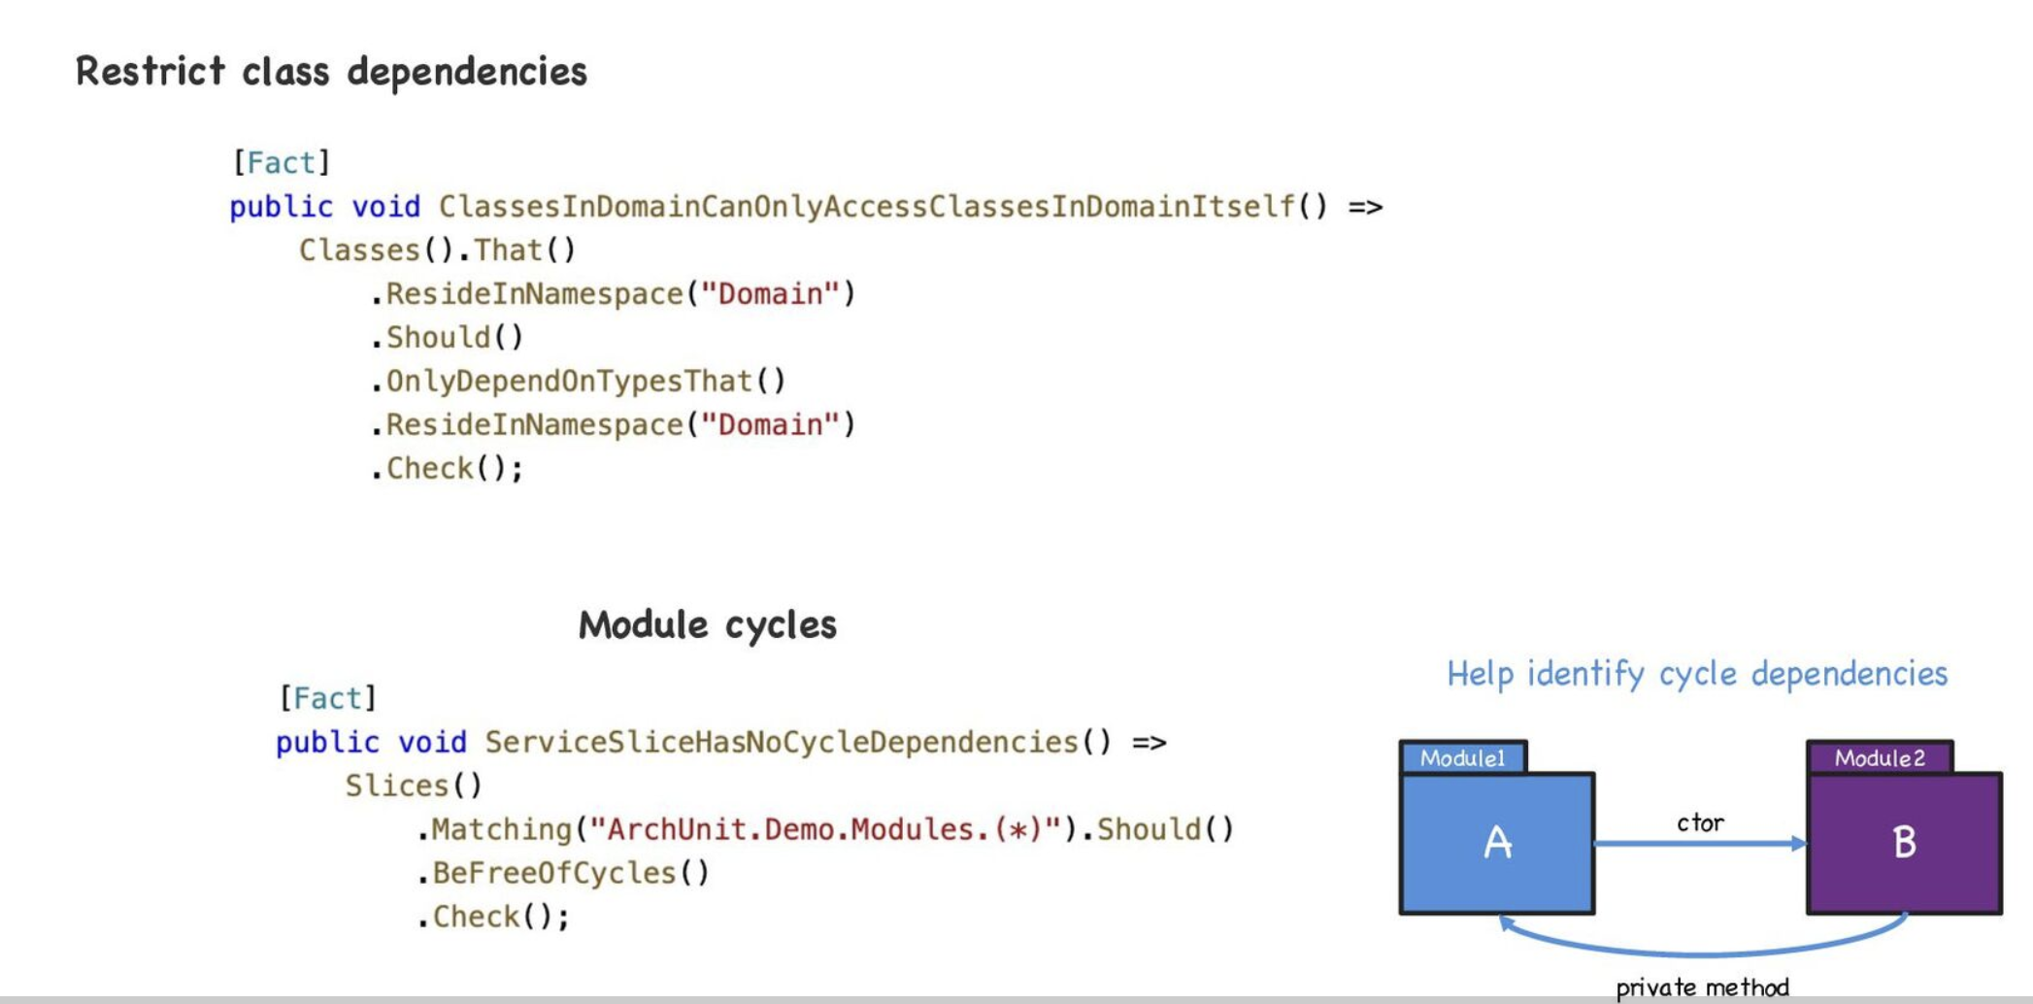
Fitness function to enforce clean Architecture: ArcUnit

Slide 26
Questions ?
Alexandru Lungu
alexandru.lungu@eon.com

Slide 27

Thank you for your presence.
Alexandru Lungu
alexandru.lungu@eon.com

Slide 28

Thank you

